Slide 1
INTRODUCTION TO
FUNCTIONAL PROGRAMMING
HASKELL

Slide 2
What is Functional Programming?
Opinions differ, and it is difficult to give a precise definition, but generally speaking:
Functional programming is style of programming in which the basic method of computation is the application of functions to arguments;
A functional language is one that supports and encourages the functional style.

Slide 3
Why is it Useful?
Again, there are many possible answers to this question, but generally speaking:
The abstract nature of functional programming leads to considerably simpler programs;
It also supports a number of powerful new ways to structure and reason about programs.

Slide 4

Some maths review

Slide 5
LECTURE 1
THE INTERPRETER

Slide 6
What is WinGHCi?
An interpreter for Haskell, and the most widely used implementation of the language;
An interactive system, which is well-suited for teaching and prototyping purposes;
Hugs is freely available from:
http://www.haskell.org/ghc/download_ghc_64

Slide 7
The Standard Prelude
When WinGHCi is started it first loads the library file Prelude.hs, and then repeatedly prompts the user for an expression to be evaluated.
For example:
> 2+3*4
14
> (2+3)*4
20

Slide 8
The standard prelude also provides many useful functions that operate on lists. For example:
> length [1,2,3,4]
4
> product [1,2,3,4]
24
> take 3 [1,2,3,4,5]
[1,2,3]

Slide 9
Try more commands
> 5 == 5
True
> 1 == 0
False
> 4 /= 5
False
> False || True
True
> False && True
False
> not True
False

Slide 10
…and more commands
> min 9 10
9
> min 3.4 3.2
3.2
> max 100 101
101
> succ 9 + max 5 4 + 1
16
> (succ 9) + (max 5 4) + 1
16
> div 10 2
> 5
> 10 `div` 2
5

Slide 11
function Application
In mathematics, function application is denoted using parentheses, and multiplication is often denoted using juxtaposition or space.
f(a,b) + c d
Apply the function f to a and b, and add the result to the product of c and d.

Slide 12
In Haskell, function application is denoted using space, and multiplication is denoted using *.
f a b + c*d
As previously, but in Haskell syntax.

Slide 13
Moreover, function application is assumed to have higher priority than all other operators.
f a + b
Means f (a) + b, rather than f (a + b).

Slide 14
Examples
Mathematics
Haskell
f(x)
f x
f(x,y)
f x y
f(g(x))
f (g x)
f(x,g(y))
f x (g y)
f(x)g(y)
f x * g y

Slide 15
My First Script
When developing a Haskell script, it is useful to keep two windows open, one running an editor for the script, and the other running Hugs.
Start an editor, type in the following two function definitions, and save the script as test.hs:
double x = x + x
quadruple x = double (double x)

Slide 16
Leaving the editor open, in another window start up Hugs with the new script:
> :l C:\\haskell\\double.hs
Now both Prelude.hs and test.hs are loaded, and functions from both scripts can be used:
> let numb = 5
> double numb
> 10
> quadruple 10
40
> take (double 2) [1..6]
[1,2,3,4]

Slide 17
Leaving WinGHCi open, return to the editor, add the following two definitions, and resave:
factorial n = product [1..n]
average ns = sum ns `div` length ns
Note:
div is enclosed in back quotes, not forward;
x `f` y is just a shortcut for f x y.

Slide 18
WinGHCi does not automatically reload scripts when they are changed, so a reload command must be executed before the new definitions can be used:
> :reload
Reading file "test.hs"
> factorial 10
3628800
> average [1..5]
3

Slide 19
Some control
A number is double only if it is less than 100. Reload and try!
doubleSmallNumber x = if x > 100
then x
else x*2

Slide 20
List Types
A list is sequence of values of the same type enclosed in square brackets:
[False,True,False]
[’a’,’b’,’c’,’d’]
[[a],[b],[c]]
[1..6]
[‘a’,4,’b’] is not a list! Not SAME type
In general:
[T] is the type of lists with elements of type T.

Slide 21
Experimenting with Lists
> let lostNumbers = [4,8,15,16,23,42]
> lostNumbers
[4,8,15,16,23,42]
> [1,2,3,4] ++ [9,10,11,12]
[1,2,3,4,9,10,11,12]
> "hello" ++ " " ++ "world"
"hello world"
> ['w','o'] ++ ['o','t']
"woot"
> 'A':" SMALL CAT"
"A SMALL CAT"
> 5:[1,2,3,4,5]
[5,1,2,3,4,5]

Slide 22
Experimenting with Lists
> "Steve Buscemi" !! 6
'B'
> [9.4,33.2,96.2,11.2,23.25] !! 1
33.2
> let b = [[1,2,3,4],[5,3,3,3],[1,2,2,3,4],[1,2,3]]
> b ++ [[1,1,1,1]]
[[1,2,3,4],[5,3,3,3],[1,2,2,3,4],[1,2,3],[1,1,1,1]]
> [6,6,6]:b
[[6,6,6],[1,2,3,4],[5,3,3,3],[1,2,2,3,4],[1,2,3]]
> b !! 2
[5,3,3,3]

Slide 23
Experimenting with Lists
> [3,2,1] > [2,1,0]
True
> [3,2,1] > [2,10,100]
True
> [3,4,2] > [3,4]
True
> [3,4,2] > [2,4]
True
> [3,4,2] == [3,4,2]
True

Slide 24
Experimenting with Lists
head takes a list and returns its head = its first element.
> head [5,4,3,2,1]
5
tail takes a list and returns its tail (list with no head).
> tail [5,4,3,2,1]
[4,3,2,1]
last takes a list and returns its last element.
ghci> last [5,4,3,2,1]
1
init takes a list and returns everything except its last element.
> init [5,4,3,2,1]
[5,4,3,2]

Slide 25
Experimenting with Lists
length takes a list and returns its length, obviously.
> length [5,4,3,2,1]
5
null checks if a list is empty.
> null [1,2,3]
False
> null []
True
reverse reverses a list.
> reverse [5,4,3,2,1]
[1,2,3,4,5]
maximum takes a list of stuff that can be put in some kind of order and returns the biggest element.
minimum returns the smallest.
> minimum [8,4,2,1,5,6]
1
> maximum [1,9,2,3,4]
9

Slide 26
Experimenting with Lists
take takes number and a list. It extracts that many elements from the beginning of the list. Watch.
i> take 3 [5,4,3,2,1]
[5,4,3]
ghci> take 1 [3,9,3]
[3]
ghci> take 5 [1,2]
[1,2]
ghci> take 0 [6,6,6]
[]
If we try to take 0 elements, we get an empty list.
drop works in a similar way, only it drops the number of elements from the beginning of a list.
> drop 3 [8,4,2,1,5,6]
[1,5,6]
> drop 0 [1,2,3,4]
[1,2,3,4]
> drop 100 [1,2,3,4]
[]

Slide 27
Experimenting with Lists
sum takes a list of numbers and returns their sum.
product takes a list of numbers and returns their product.
> sum [5,2,1,6,3,2,5,7]
31
> product [6,2,1,2]
24
> product [1,2,5,6,7,9,2,0]
0
elem takes a thing and a list of things and tells us if that thing is an element of the list.
> 4 `elem` [3,4,5,6]
True
> 10 `elem` [3,4,5,6]
False

Slide 28
Experimenting with Lists: Range
> [1..20]
[1,2,3,4,5,6,7,8,9,10,11,12,13,14,15,16,17,18,19,20]
> ['a'..'z']
"abcdefghijklmnopqrstuvwxyz"
> ['K'..'Z']
"KLMNOPQRSTUVWXYZ"
> [2,4..20]
[2,4,6,8,10,12,14,16,18,20]
> [3,6..20]
[3,6,9,12,15,18]
replicate function
> Replicate 3 10
[10,10,10]

Slide 29
Some exercises
What is the output of the following commands:
> take 6 [4,5..7]
> length ((replicate 4 5) ++ [5,6,7])
> length ((replicate 4 5) + [5,6,7])
Write a command to get the 4th element of a list using some (the ones you need) of the following functions: drop, take, init, head, last, tail.

Slide 30

Exercises
(1)
(2)
(3)

Slide 31
LIST COMPREHENSIONS

Slide 32
Set Comprehensions
In mathematics, the comprehension notation can be used to construct new sets from old sets.
{x² | x ∈ {1..5}}
The set {1,4,9,16,25} of all numbers x² such that x is an element of the set {1..5}.

Slide 33
Lists Comprehensions
In Haskell, a similar comprehension notation can be used to construct new lists from old lists.
[x^2 | x ← [1..5]]
The list [1,4,9,16,25] of all numbers x^2 such that x is an element of the list [1..5].

Slide 34
Lists Comprehensions
In Haskell, a similar comprehension notation can be used to construct new lists from old lists.
> [x*2 | x <- [1..10], x*2 >= 12]
[12,14,16,18,20]
boomBangs xs = [ if x < 10 then "BOOM!" else "BANG!" | x <- xs, odd x]
> boomBangs [7..13]
["BOOM!","BOOM!","BANG!","BANG!"]

Slide 35
Lists Comprehensions, Exercise
Using the function mod x y , write a commands to display all the numbers that can be divided by 6 from 1 to 50
ghci> [ x | x <- [1..50], x `mod` 6 == 0]
[6,12,18,24,30,36,42,48]

Slide 36
Lists Comprehensions, Exercise
What’s the output of the following commands?
> [ x | x <- [10..20], x /= 13, x /= 15, x /= 19]
> [ x*y | x <- [2,5,10], y <- [8,10,11]]
> [ x*y | x <- [2,5,10], y <- [8,10,11], x*y > 50]

Slide 37
Lists Comprehensions, Exercise
What’s the output of the following commands?
> [ x | x <- [10..20], x /= 13, x /= 15, x /= 19]
> [ x*y | x <- [2,5,10], y <- [8,10,11]]
> [ x*y | x <- [2,5,10], y <- [8,10,11], x*y > 50]
[10,11,12,14,16,17,18,20]
[16,20,22,40,50,55,80,100,110]
[55,80,100,110]

Slide 38
Lists Comprehensions, Exercise
What’s the output of the following command?
> let nouns = ["hobo","frog","pope"]
> let adjectives = ["lazy","grouchy","scheming"]
> [adjective ++ " " ++ noun | adjective <- adjectives, noun <- nouns]
["lazy hobo","lazy frog","lazy pope","grouchy hobo","grouchy frog",
"grouchy pope","scheming hobo","scheming frog","scheming pope"]

Slide 39
Lists Comprehensions, Exercise
What’s the output of the following commands?
mystery1 xs = sum [1 | _ <- xs]
mystery2 st = [ c | c <- st, c `elem` ['A'..'Z']]
> mystery2 "Hahaha! Ahahaha!"
"HA"
> mystery2 "IdontLIKEFROGS"
"ILIKEFROGS"

Slide 40
Note:
The expression x ← [1..5] is called a generator, as it states how to generate values for x.
Comprehensions can have multiple generators, separated by commas. For example:
> [(x,y) | x ← [1..3], y ← [1..2]]
[(1,1),(1,2),(2,1),(2,2),(3,1),(3,2)]

Slide 41
Changing the order of the generators changes the order of the elements in the final list:
> [(x,y) | y ← [1..2], x ← [1..3]]
[(1,1),(2,1),(3,1),(1,2),(2,2),(3,2)]
Multiple generators are like nested loops, with later generators as more deeply nested loops whose variables change value more frequently.

Slide 42
Dependant Generators
Later generators can depend on the variables that are introduced by earlier generators.
[(x,y) | x ← [1..3], y ← [x..3]]
The list [(1,1),(1,2),(1,3),(2,2),(2,3),(3,3)]
of all pairs of numbers (x,y) such that x,y are elements of the list [1..3] and x ≤ y.

Slide 43
Guards
List comprehensions can use guards to restrict the values produced by earlier generators.
[x | x ← [1..10], even x]
The list [2,4,6,8,10] of all numbers x such that x is an element of the list [1..10] and x is even.

Slide 44
Using a guard we can define a function that maps a positive integer to its list of factors:
factors :: Int → [Int]
factors n = [x | x ← [1..n]
, n `mod` x == 0]
For example:
> factors 15
[1,3,5,15]

Slide 45
A positive integer is prime if its only factors are 1 and itself. Hence, using factors we can define a function that decides if a number is prime:
prime :: Int → Bool
prime n = factors n == [1,n]
For example:
> prime 15
False
> prime 7
True

Slide 46
Using a guard we can now define a function that returns the list of all primes up to a given limit:
primes :: Int → [Int]
primes n = [x | x ← [1..n], prime x]
For example:
> primes 40
[2,3,5,7,11,13,17,19,23,29,31,37]

Slide 47
An interesting example
Using a generator we can define the library function that concatenates a list of lists:
For example:
> concat [[1,2,3],[4,5],[6]]
[1,2,3,4,5,6]
concat xss = [x | xs ← xss, x ← xs]

Slide 48
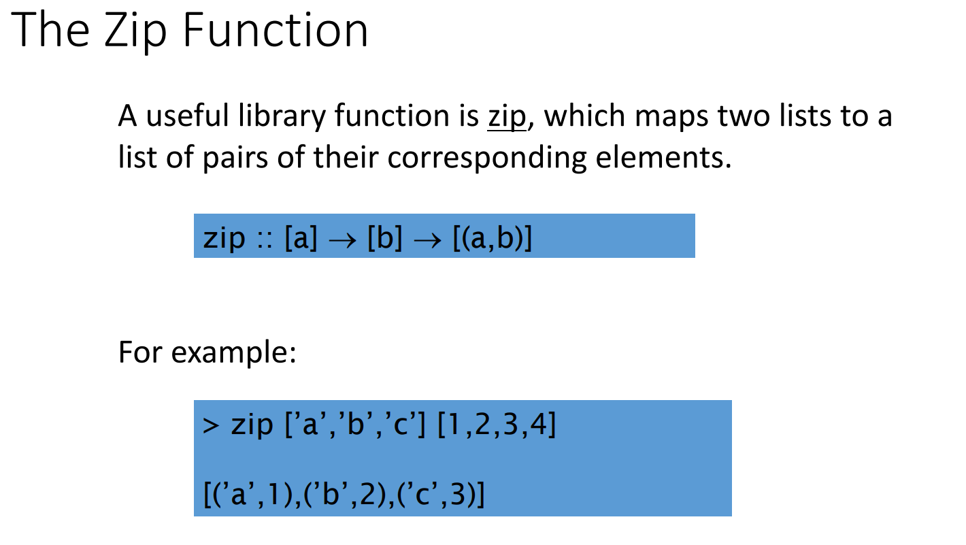
The Zip Function

Slide 49
Exercises
(1)
A pythagorean triad is triple (x,y,z) of positive integers such that x² + y² = z². A triad define a right triangle. Using a list comprehension, define a function that returns all the right triangles x,y,z where x and y are in the range [1..100].

Slide 50
Exercises
(2)
Get the position of the first occurrence of an element in a list.
Hint: one way is to use zip to assign an index to each element…

Slide 51
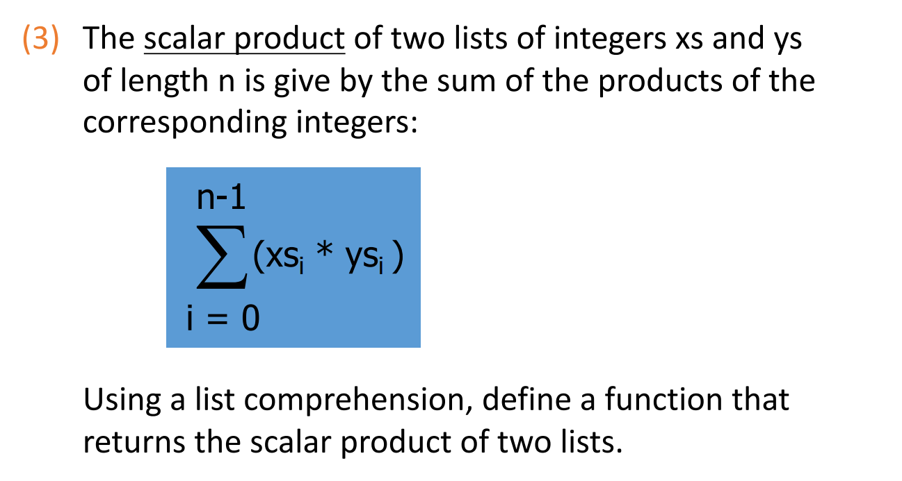
Exercises

